Slide 1
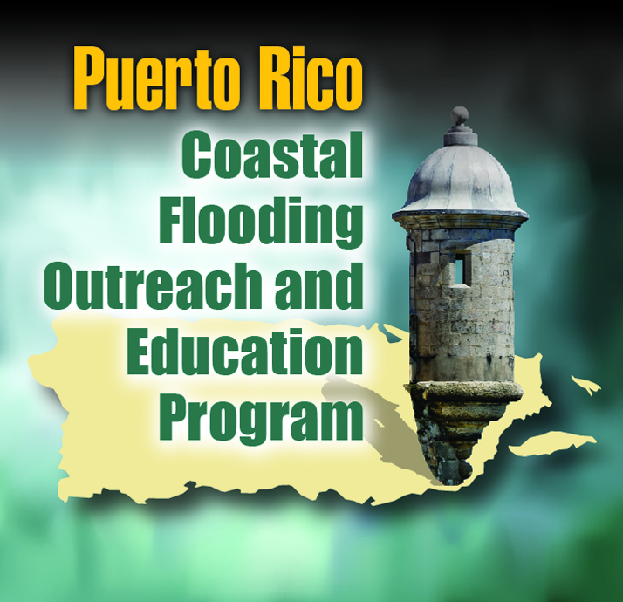
Coastal Outreach Advisory Team FEMA Region II
COAT Kickoff Meeting
April 4, 2013, 10:00 a.m.
Alejandro De La Campa, FEMA Region II-Caribbean Division Director Carmen Iris Delgado, CFM, FEMA Region II - CAD–Floodplain Management Heidi M. Carlin, CFM, Risk Analysis, Mapping, and Planning Partners
Notes:
After we play the Region 2 Coastal video 5 minutes before beginning at 10 AM, Aljandro to kick off the meeting and then ask Tim to welcome the group also.
Alejandro Presenting:
This is a kickoff meeting to an advisory group
Collaboration between FEMA and locals
FEMA wants to know how the outreach is working and wants feedback from COAT members.

Slide 2
Agenda
Welcome
Coastal Outreach Advisory Team (COAT) Overview
Risk MAP Program
Technical Projects Underway
Outreach Efforts
Questions/Discussion
Notes:
Heidi to Take Roll: ask who is on the phone and then check off list of sign in sheet of people in the room and ask if anyone has not yet signed in.

Slide 3
COAT
Overview
Notes:
Heidi Presenting

Slide 4
What is the COAT?
Mission Statement
To maximize citizen, public official, and key stakeholder awareness and understanding of, and engagement in the flood study process, as well as awareness and understanding of other natural hazards.
COAT members actively participate by discussing outreach and communication opportunities, identifying potential issues, and providing input on strategies and tactics for communicating about flood risk and other natural hazards.
Notes:
Heidi Presenting

Slide 5
Who should participate?
Organized by FEMA
Supported by RAMPP
Local Partners and Community Officials
Academic institution representatives
Non-profit representatives
Federal agency partners
Private sector
Notes:
Heidi Presenting

Slide 6
What do COAT members do?
Provide input on strategy and tactics for communicating about coastal flood risk and other natural hazards.
Share ideas for development and implementation of outreach programs and materials.
Serve as word of mouth marketers among fellow stakeholders, including colleagues, neighbors, friends, and family members.
Notes:
Heidi Presenting

Slide 7
An Example: NJ/NY COAT
Helped develop overall key messaging
Know Your Risk. Know Your Role. Take Action.
Assisted in the editing and distribution of
www.region2coastal.com
Liberty Science Center Poster
Region II Coastal Video
Assisted in the distribution of important information and training invitations related to ongoing coastal study
ABFE effort
Liaison between local communities and FEMA Region II
Transmitted local feedback to FEMA Region II
Helped to disseminate accurate messaging about ABFEs
“Boots on the ground”
Notes:
Heidi Presenting
The NJ/NY COAT provides support to Region II’s coastal projects.
Region II uses the COAT as a platform to not only provide awareness but as a way to gather input and feedback on outreach activities
The NJ/NY COAT assisted in the creation of key messages to be used by COAT members communicating with communities.
Region II developed a website, video, poster and additional resources (i.e. fact sheets) and utilized the COAT for suggestions and feedback
When Region II holds a training or has information to be distributed to communities, the COAT assists in bringing awareness to their colleagues and those in their communities.
Following Hurricane Sandy, FEMA decided to release advisory base flood elevations (ABFEs). Region II used the COAT to get the word out to their communities about this upcoming effort.
NJ/NY COAT are the boots on the ground for Region II – the members are FEMA’s eyes and ears in the communities

Slide 8
The Risk MAP Program
Overview
Notes:
Heidi Presenting

Slide 9
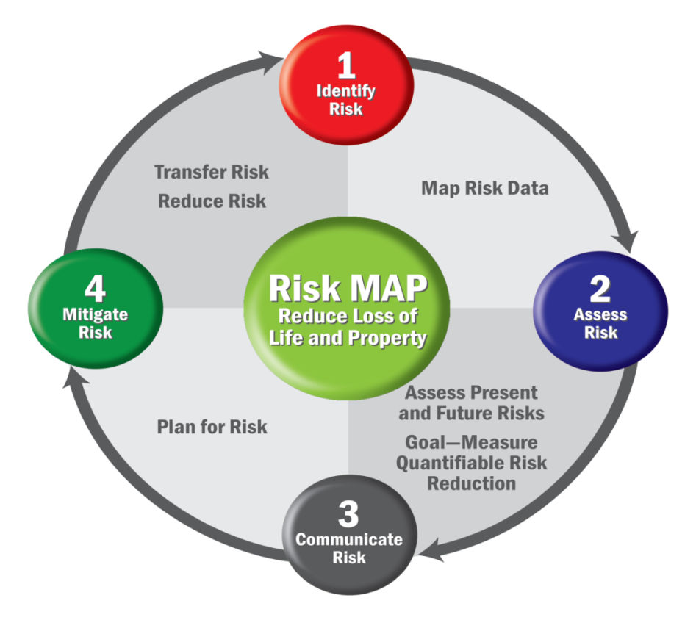
What is Risk MAP?
Risk MAP
Mapping – Flood hazard and risk identification
Assessment – HAZUS and other risk assessment tools
Planning – Hazard mitigation planning and HMA grants
Risk MAP Vision
Deliver quality data
Increase public awareness of flood risk
Encourage local/regional actions that reduce risk
Notes:
Heidi Presenting
Risk MAP is a FEMA program with the following vision: Through collaboration with Commonwealth/State, local, and Tribal entities, Risk MAP will deliver quality data that increases public awareness and leads to action that reduces risk to life and property

Slide 10
Risk MAP Program Overview (continued)
Through Risk MAP, FEMA works with communities to develop flood risk products and flood hazard maps that are:
Based on the best available data from the community and latest technologies
Conducted by watershed
Strengthened by partnerships
Communities can use Risk MAP tools and data to:
Create or improve Hazard Mitigation Plans
Make informed decisions about development, ordinances, and flood mitigation projects
Communicate with citizens about flood risk
Notes:
Heidi Presenting

Slide 11
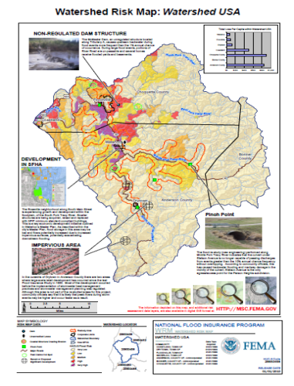
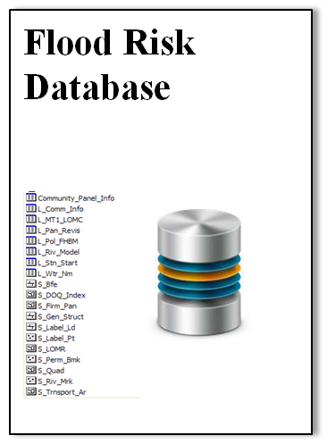
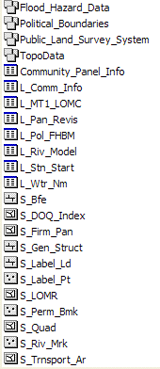
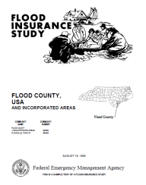
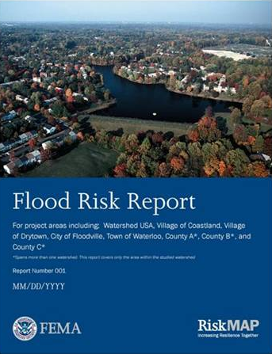
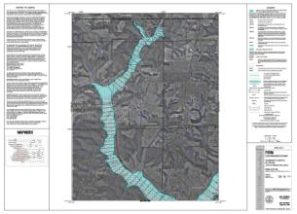
Risk MAP Product Comparisons
Traditional Regulatory Products
Non-Regulatory Products
DFIRM Database
FIRM Database
Flood Risk Database
Traditional products are regulatory and subject to statutory due-process requirements
Non-regulatory products are not subject to statutory due-process requirements
Notes:
Heidi Presenting
Flood hazard area mapping pre-Risk MAP generated 3 main types of products that all familiar with the Flood Insurance Rate Map (FIRM) process have come to know and understand
Flood Insurance Rate Map (FIRM) Database
Flood Insurance Study (FIS) Report
Flood Insurance Rate Maps (FIRMs)
Risk MAP does not seek to replace the FIRM flagship products (FIRM DB, FIS report, and the map itself) – those will still be produced for each study. However, we want to align our new datasets/products with an existing structure and follow the same general model.

Slide 12
Risk MAP Project Timeline
Discovery Meeting
Flood Study Review
Resilience Meeting
Final CCO Meeting
Project Kickoff*
3-5 Year Process
*Kickoff and subsequent steps will only occur if a Risk MAP project is conducted.
Notes:
Heidi Presenting
Discovery meeting is intended to gather information to determine whether a revised flood hazard area map is needed. It is intended to gather all information available from communities, such as additional topographic information, local flood studies, etc., and share this information with FEMA and their contractor or CTP (Cooperating Technical Partner) to include later on in the study, should it be decided the area needs a new hazard map.
Project kickoff occurs once it has been decided a revised flood hazard map is needed along with Risk MAP products.
Flood Study Review is the time it takes to conduct the study, run the flood models, and create a revised flood hazard map.
Resilience Meeting is part of Risk MAP and incorporates information on mitigation and resilience The Resilience Meeting is one of several watershed-wide meetings (and the second meeting required) that the project team has with community officials and other key stakeholders during a Risk MAP project. The purpose of the meeting is to continue to build local capacity for implementing priority mitigation activities within the watershed.
Final CCO Meeting stands for Consultation Coordination Officer meeting where the preliminary maps are introduced to the communities and the 90 day appeals period begins. CCO Meeting is a meeting held by the project team for the local officials in communities receiving new or updated regulatory products (FIRM and FIS report).

Slide 13
Technical Projects Underway
Notes:
Alejandro Presenting

Slide 14
Puerto Rico Technical Projects
1. Discovery
2. Hazus Multi-Hazard Support
3. Rio Grande de Loiza Restudy
Notes:
Alejandro Presenting

Slide 15
Puerto Rico Discovery
Notes:
Alejandro Presenting

Slide 16
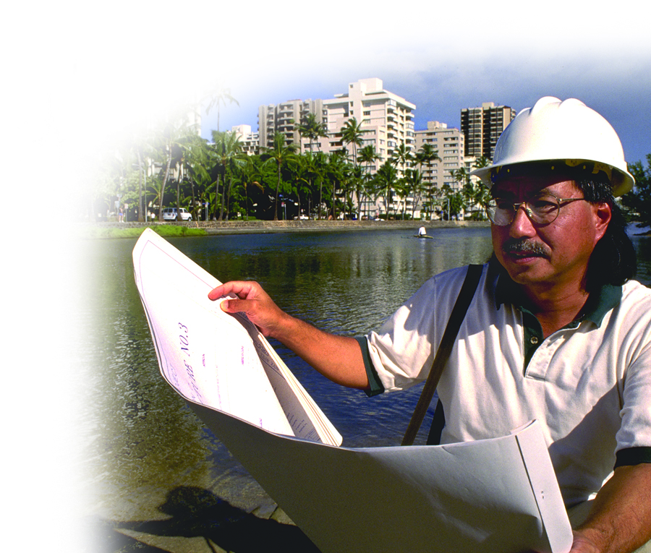
What is ‘Discovery’?
First step in the Risk MAP project process
Begins a dialogue about flood risk with communities and other stakeholders to:
Understand needs and priorities
Communicate available resources
Offer partnerships and answer questions
Give a complete, current picture of local flood hazards and risks to help communities:
Plan for the risk
Take action to protect their communities
Communicate the risk to citizens
Notes:
Alejandro Presenting
Mention that Discovery does not lead to a study in every case.
Discuss how the watershed is selected and what are the change indicators in the watershed that brought FEMA to this area for Discovery.

Slide 17
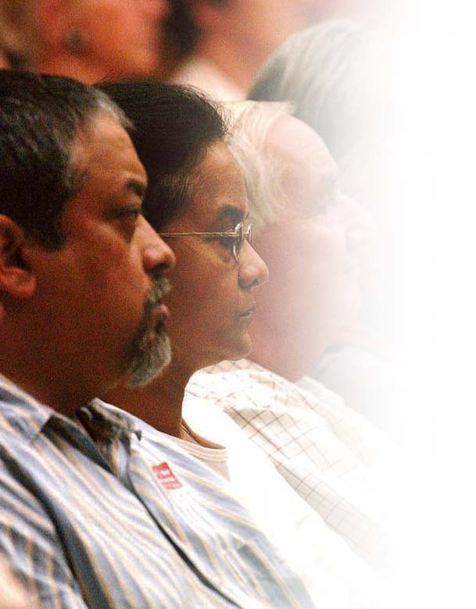
The Discovery Process
Data Collection
Collect information about the communities in the watershed
Develop draft Discovery Report and Map
Discovery Meeting
Present potential flood risk products and get feedback
Discuss and prioritize areas needing flood risk study
Discuss local planning and communication assistance
Outcome
Finalize Discovery Report and Map
Develop a scope of work and budget for Risk MAP project
Determine available local contributions
Notes:
Alejandro Presenting
The goal of Discovery is to learn where flood hazards are, what risk they pose, and how communities addresses that risk
Review local flood hazards and risk
Understand local mitigation capabilities, hazard risk assessments, and current or future mitigation activities
Collect information about flooding history, development plans, daily operations, and stormwater and floodplain management activities
During Discovery, the goal is to identify where the following may help:
New or updated flood hazard information based on engineering studies
Additional flood risk assessments
Hazard mitigation planning technical assistance

Slide 18
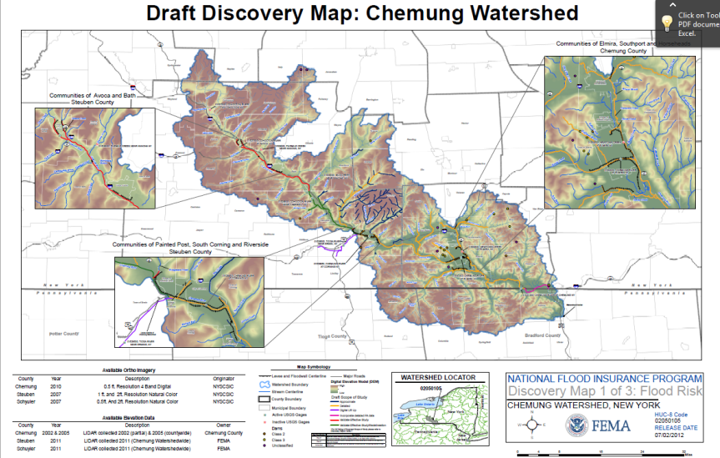
Puerto Rico Discovery Project
To be performed by the Puerto Rico Planning Board in coordination with FEMA
Timeline
Project Area
Notes:
Alejandro Presenting

Slide 19
Puerto Rico Discovery: Discussion
Stakeholders to Include in Process
Potential Data Sources
Flooding Problems/ Priority Areas
Accuracy of current FIRM
Development Plans
Areas of High Population Growth
Current/Future Mitigation Activities
Notes:
Alejandro Presenting
The points on this slide are what would be discussed during the Discovery meetings

Slide 20
Hazus-MH Support
Notes:
Iris Presenting

Slide 21
What Is Hazus?
Software tool and support system designed by FEMA
Provides communities with the means to identify and reduce risk from different natural hazards, including flooding, hurricanes, and earthquakes
IDENTIFY vulnerable areas
ASSESS level of readiness and preparedness to deal with a disaster before disaster occurs
ESTIMATE potential losses from specific hazard events
DECIDE on how to allocate resources for most effective and efficient response and recovery
PRIORITIZE mitigation measures that need to be implemented to reduce future losses (what if)
Notes:
Iris Presenting

Slide 22
Hazus Support for Puerto Rico
FEMA, with the support of RAMPP, will enable the Puerto Rico Planning Board with Hazus capabilities by:
Producing a working application to model hurricane winds and coastal flood modeling in Puerto Rico using Hazus-MH
Providing Hazus-MH module training for PR Planning Board
Floods
Hurricanes
Earthquakes
Updating data inventories for 3 Municipios
These efforts will inform the Discovery process
Notes:
Iris Presenting
RAMPP is the contractor assisting in this effort. Stands for Risk Analysis, Mapping, and Planning Partners.
Puerto Rico needs a method for determining their risks from hurricanes and floods for mitigation planning.
Training will (among other things) allow the PRPB to perform Average Annualized Loss analysis which will inform the Discovery process.

Slide 23
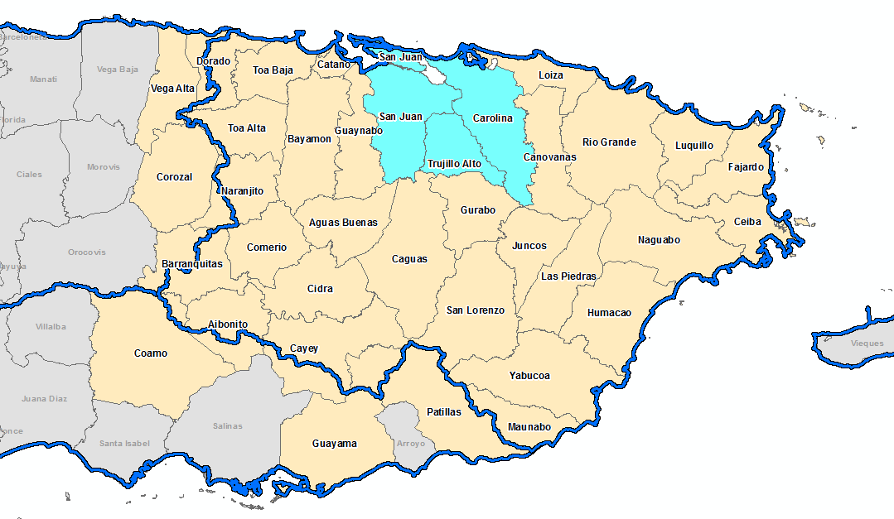
Study Area
HUC 8 (21010005)
Municipios de Carolina, San Juan y Trujillo Alto
Notes:
Iris Presenting
The United States and Puerto Rico is divided and sub-divided into successively smaller hydrologic units which are classified into four levels: regions, sub-regions, accounting units, and cataloging units. The hydrologic units are arranged or nexted within each other, from the smallest (cataloging units) to the largest (regions). Each hydrologic unit is identified by a unique hydrologic unit code (HUC) consisting of two to eight digits based on the four levels of classification in the hydrologic unit system.
Updated data inventories for the 3 municipios highlighted.
PR Planning Board to perform AAL loss analysis for the HUC 8 area shown.

Slide 24
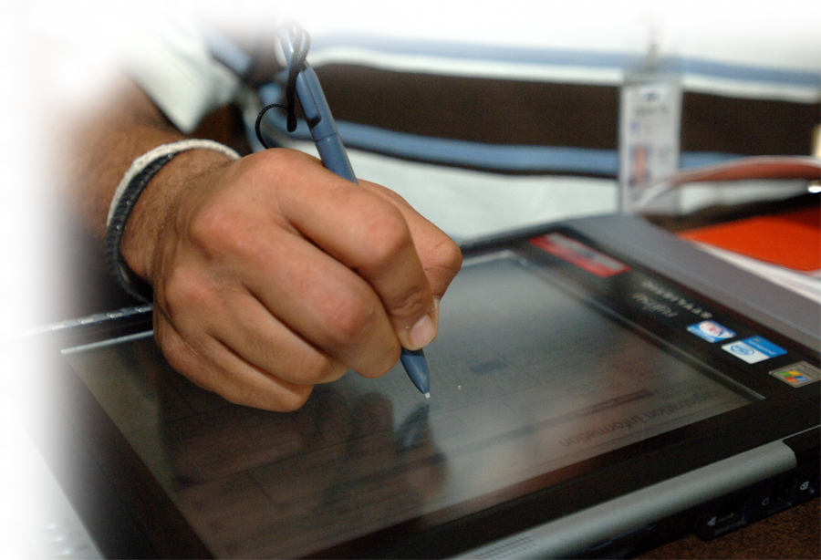
Phase 1: Data Collection
Collection of data to populate Hazus-MH feature classes underway
Hazard Data
Base Map Data
What/Who is at Risk?
Coordination with CRIM to acquire critical parcel data
Occupancy class
Square footage
Assessed value
Construction type
Foundation type
Year built
***Results are only as good as the inputs.***
Notes:
Iris Presenting

Slide 25
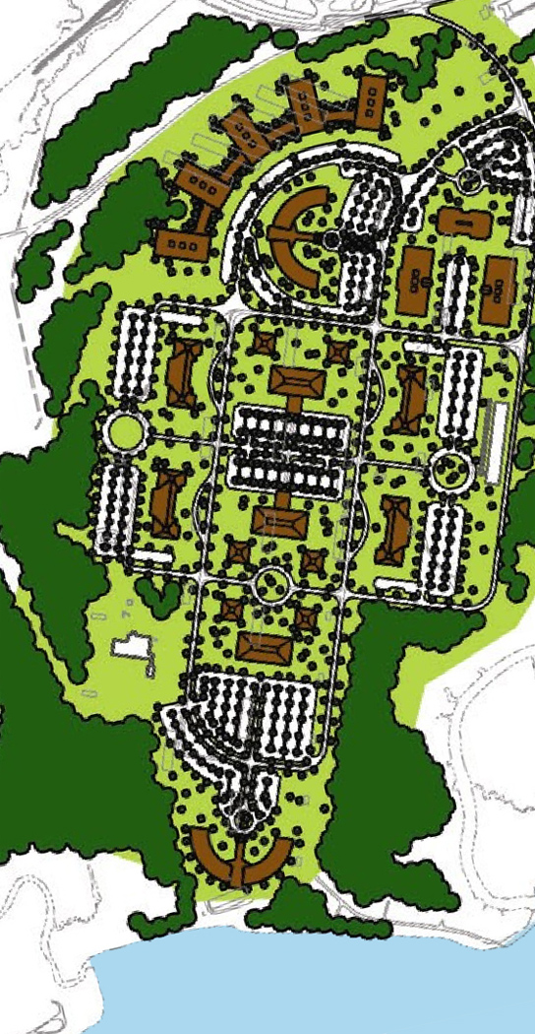
Project Goals
Develop GIS-based risk assessment capacity in Puerto Rico to identify risk within communities.
Collect best available hazard and building inventory data.
Provide additional ability for the Puerto Rico Planning Board to aid communities with creating DMA2000 compliant risk assessments.
Help inform the Risk MAP Discovery process.
Support future disaster response activities.
Notes:
Iris Presenting

Slide 26
Rio Grande de Loiza Restudy
Notes:
Iris Presenting

Slide 27
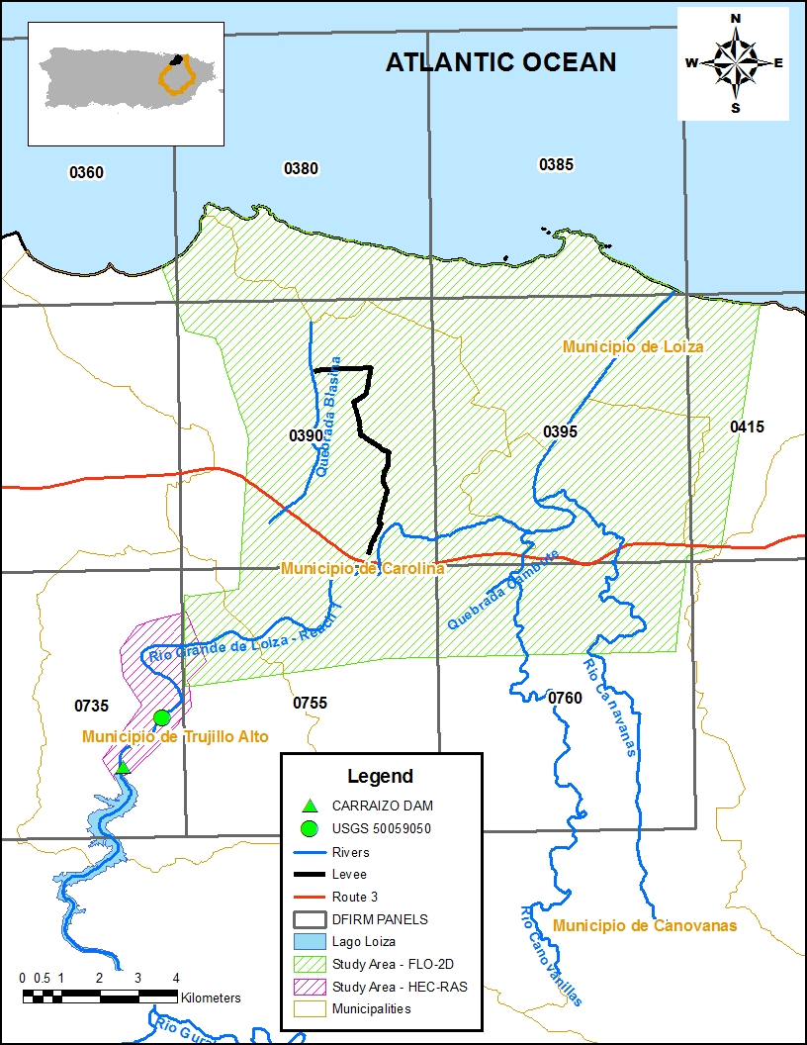
Restudy of Rio Grande de Loiza
Purpose
Updates to the floodplain and floodway modeling for the full reach of Rio Grande de Loiza — Reach 1
Affects 9 Flood Insurance Rate Map (FIRM) Panels
Study Area
Rio Grande de Loiza — Reach 1 from its mouth upstream to Carraizo Dam
Rio Canovanillas, Rio Canovanas downstream of Route 3
Located in 4 Municipios (Canovanas, Carolina, Trujillo Alto and Loiza)
Methodology
FLO-2D / HEC-RAS/HEC-HMS
Notes:
Iris Presenting

Slide 28
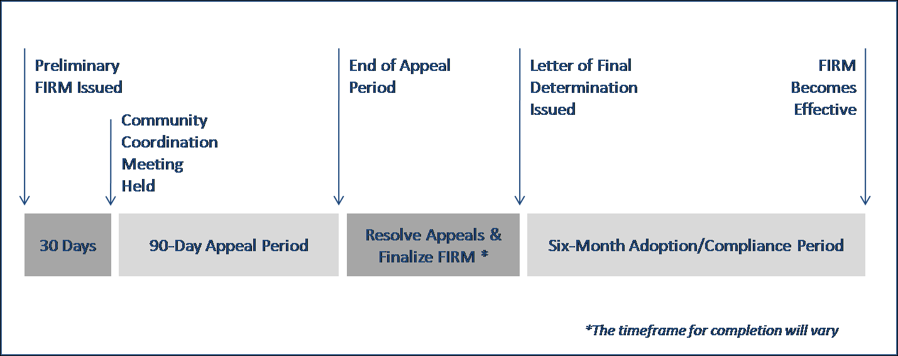
Restudy of Rio Grande de Loiza
Preliminary FIRM issued June 12, 2012 (Available for viewing at https://www.rampp-team.com/pr_vi.htm)
90-day appeal period currently underway through May 18, 2013
Notes:
Iris Presenting

Slide 29
Outreach Efforts
Notes:
Alejandro Presenting

Slide 30
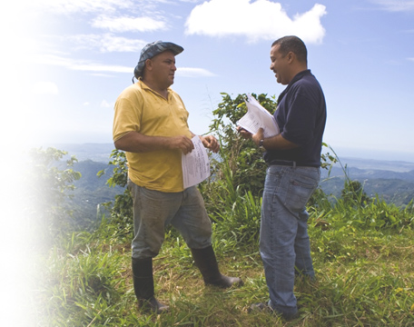
Outreach is Critical
Maximize public and private sector awareness of and engagement in the flood study process
Increase public awareness and understanding of risk from floods & other natural hazards plus options for minimizing their risk
Provide communities with effective outreach tools
Notes:
Alejandro Presenting

Slide 31
Outreach Efforts
Currently developing an outreach strategy complete with goals, measureable objectives, stakeholder lists, key messages, tactics, and evaluation methods
Tactics include fact sheets and web content about flood and natural hazard risk in Puerto Rico and the U.S. Virgin Islands and information designed to raise awareness among visitors and retirees
Efforts focus on promoting low-cost mitigation actions
We want your input!
Notes:
Alejandro Presenting

Slide 32
COAT Contacts
For more information, contact:
Carmen Iris Delgado, CFM
FEMA, Caribbean Division
Carmen.Delgado@fema.dhs.gov
787-296-3507
Heidi M. Carlin, CFM
RAMPP Region II
Heidi.Carlin@urs.com
410-725-7414
Notes:
Alejandro Presenting

Slide 33
Questions?
Notes:
All Presenters and others on the internal FEMA/RAMPP team to Participate in Answering Questions

